Slide 1
Types of cells

Slide 2
Types of galvanic cells
Primary cells
Secondary cells
Fuel cells

Slide 3
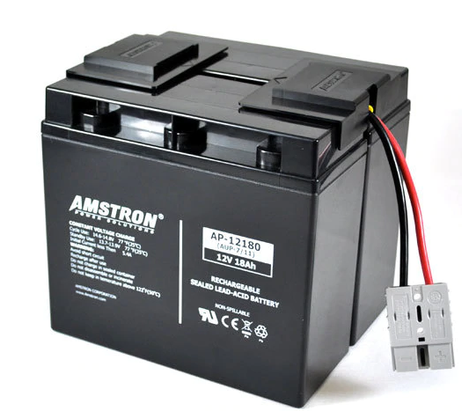


Primary cells
Simplest, inexpensive, non rechargeable cell.
Produces max voltage of 1.5 V.
Eg dry cells, alkaline cells

Slide 4
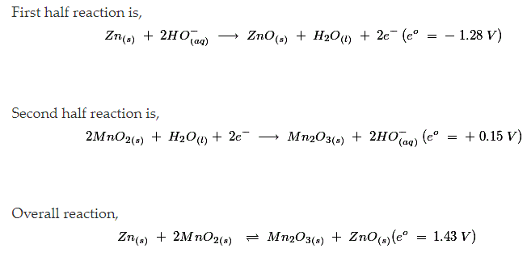
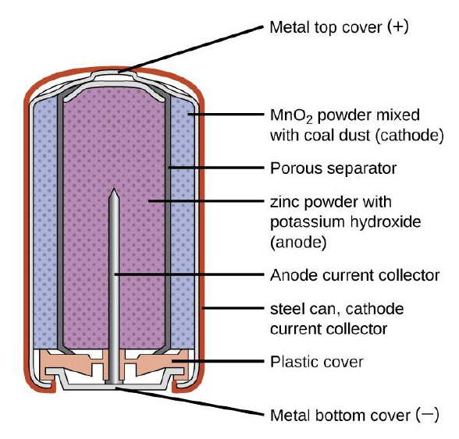
Alkaline Cell Battery

Slide 5
Secondary Cell
Rechargeable
The DC voltage forces currents through the cell, in an opposite direction.
Car batteries, lithium-ions cells, Nickle metal hydride cells, accumulators.
When it discharged- acts as a galvanic cell, converting chemical energy into electrical.
When it recharged- acts as an electrolytic cell, converting electrical energy into chemical.

Slide 6
Lead acid Cell
Lead acid battery is a secondary battery. The chemical reactions taking place in secondary cells are reversible.
The chemical process of obtaining current from a secondary battery, that is, the forward reaction, is called discharge. The process of reproducing active materials is called Recharging.

Slide 7
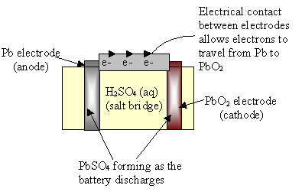
Lead acid accumulator Structure
Electrodes-
Anode- Spongy lead- large surface area
Cathode- lead(IV) oxide PbO₂ powdered on a metal grid.
Electrolyte- Conc H₂SO₄ (4.5M)

Slide 8
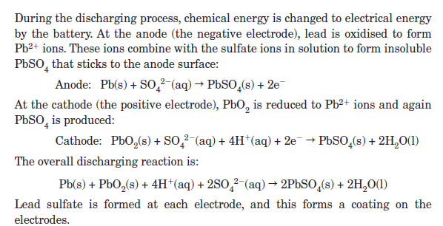

LEAD ACID BATTERY

Slide 9
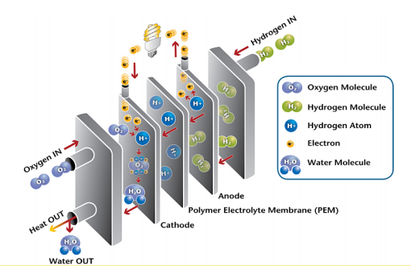
Fuel cells
A type of galvanic cell
A fuel cell produces electricity through a chemical reaction, but without combustion. It converts hydrogen and oxygen into water, and in the process also creates electricity. It’s an electro-chemical energy conversion device that produces electricity, water, and heat.
Electrodes consists of porous platinum or graphite
Electrolytes can be either basic or acidic.
Reactants are usually gases.
Supply electricity as reactants are fed into them

Slide 10
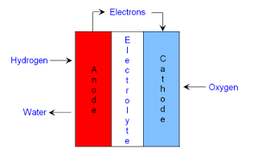
Fuel Cells

Slide 11
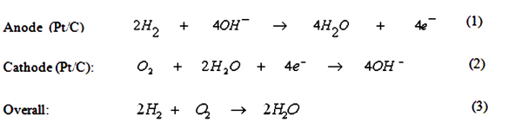
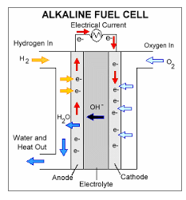
Alkaline fuel cell- basic electrolyte

Slide 12
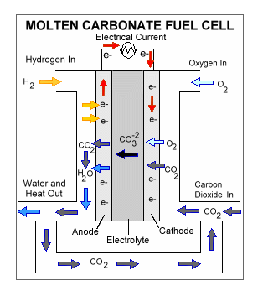
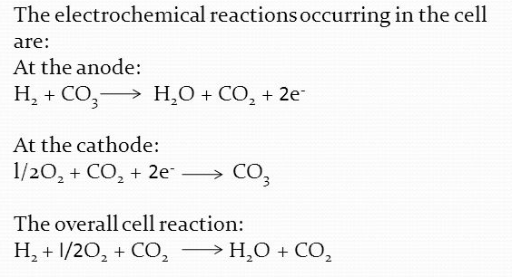
Carbonate Fuel cell
Molten carbonate is used as an electrolyte

Slide 13
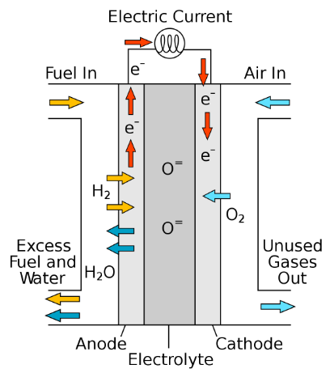
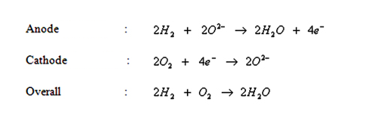
Solid Oxide Fuel cells
Electrolyte- solid oxide or ceramic electrolyte.

Slide 14
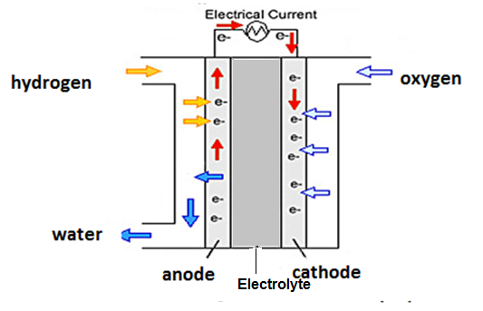


FUEL CELL- Summary

